Slide 1
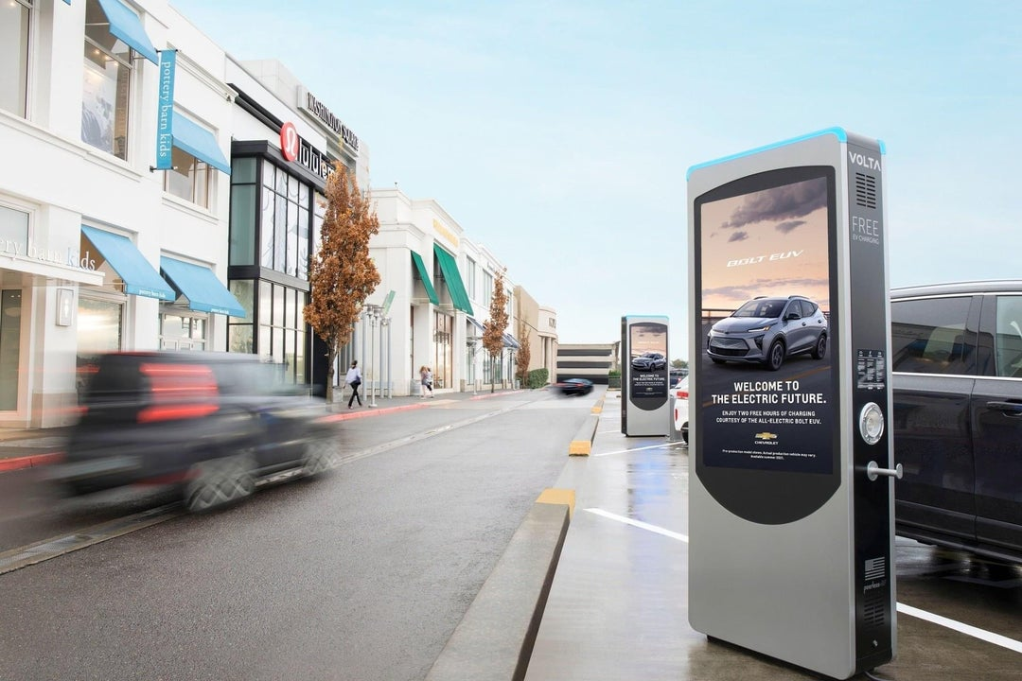


Charging Away from Climate Change
Presented by
Sabrina Yang

Slide 2
Backstory
Climate Solution
A clean transportation future with zero emission vehicles
Biden wants to build 500,000 EV Charging Stations by 2030
Chicken & Egg
Where will they go?
More Stations,
more ppl willing to buy EV
Private Companies
Who brings solutions can gain favor

Slide 3

Target: Volta Charging Business Model & Site Selection
Location = Ad reach
EV needs
High Traffic Location
Economic

Slide 4
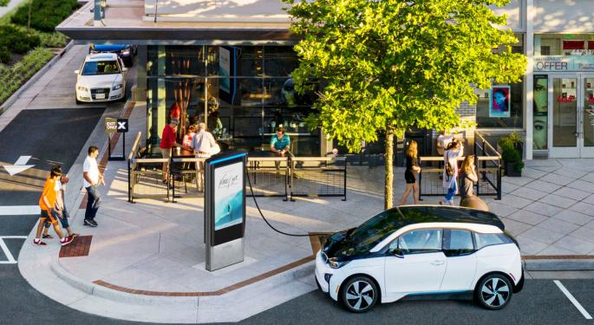
Volta Charging Station Ideal Look
Advertising
Store Revenue
Store
Eco
Save
money & Time

Slide 5
Data Science Solution
01
WHAT
Identify WHAT variables that are important to EV stations site selections
02
WHERE
Choose WHERE in NYS the highest potential market exists to build EV stations
03
WHEN
Forecast WHEN EV stations may have higher demand to meet the market need as EV users’ growth

Slide 6

Impact Hypothesis
Choosing the optimal
charging station locations
will help the business to develop a competitive advantage and acquire defensible market share from competitors.
75%

Slide 7
Datasets
EV Ownership & Sales
Check by County
From NYS DMV
EV Charing Stations
Existing Stations Map
Daily Traffic
Annual Average Daily Traffic Volume
Sales Tax &
Population
More likely to spend
EDA
Source: NYS Gov data

Slide 8
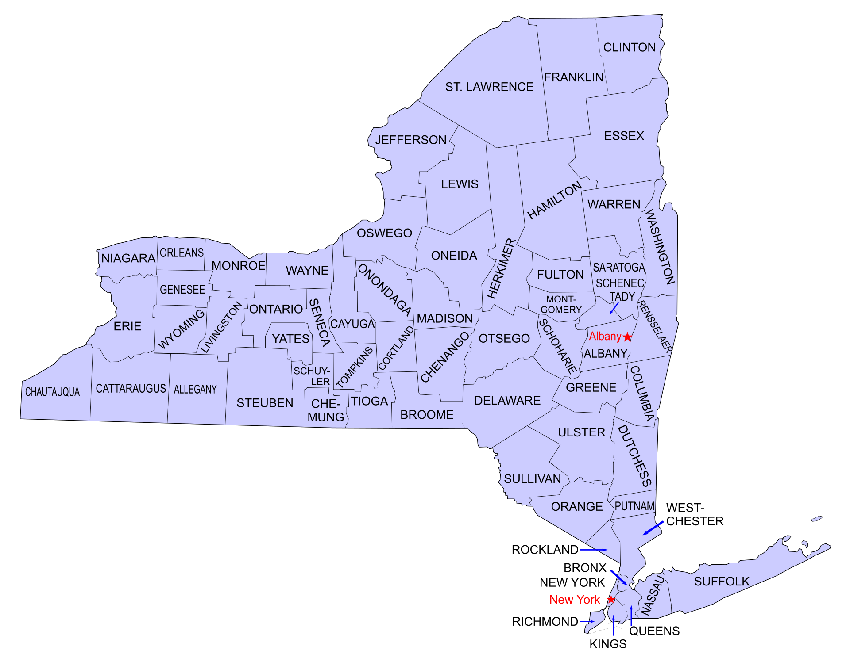
NYS County Map
63 Counties

Slide 9
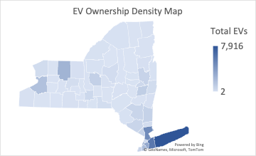
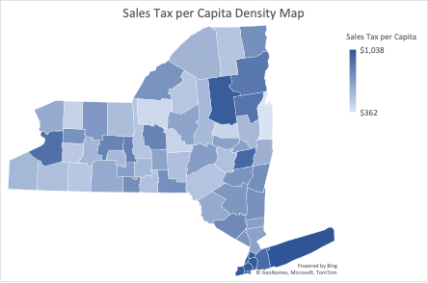
Analysis – Features
$$$
EV Sales/Ownerships are likely to happen in a higher Sales Tax per Capita County

Slide 10
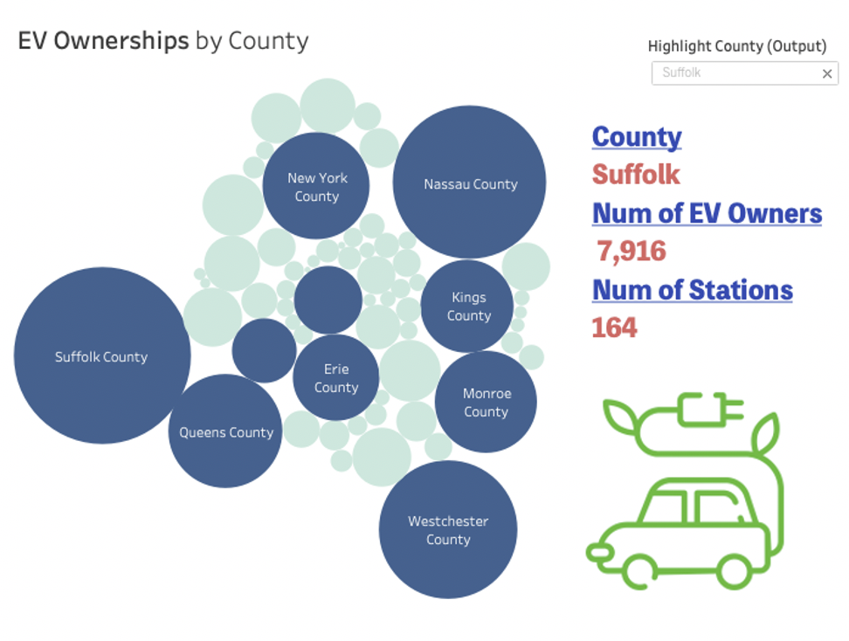

Slide 11
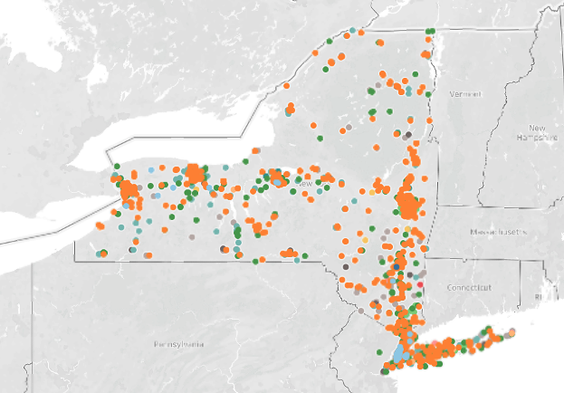
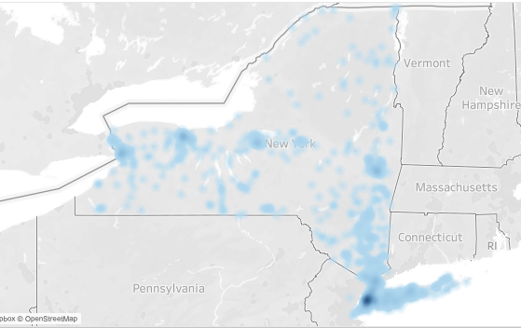
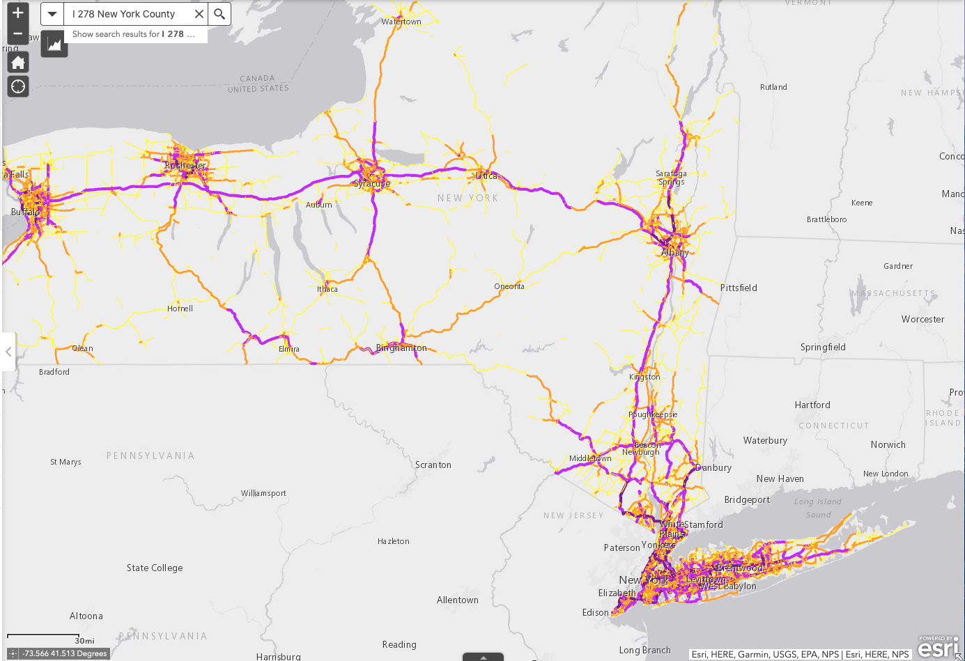
Analysis – Features
EV Stations Density Map
Daily Traffic Volume Map
EV Charging Stations are building along with High Traffic Locations

Slide 12
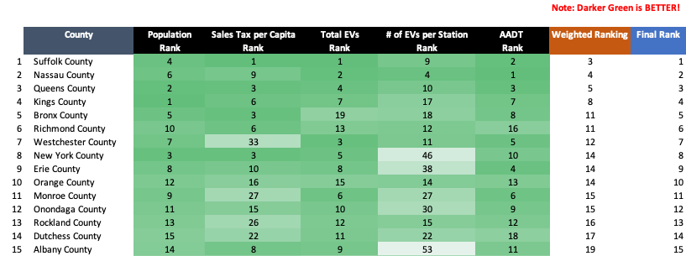
Analysis – Ranking

Slide 13
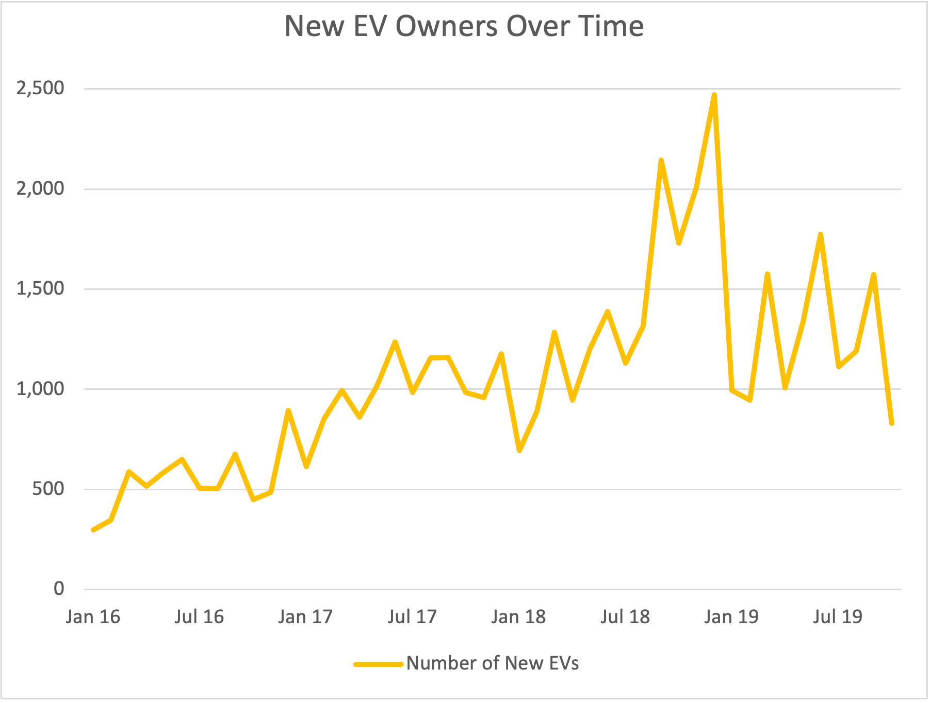
Analysis – EV Owners & Sales
Peak in 2018
Drop in 2019

Slide 14
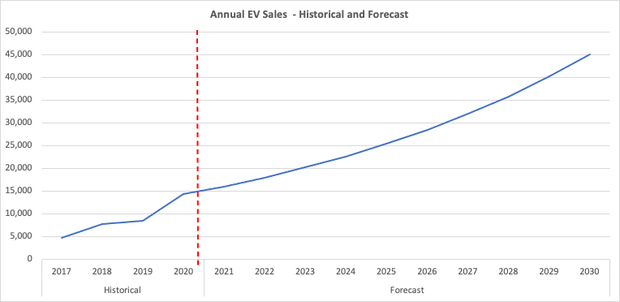
Projection
Forecast EV sales (demands) in NYS

Slide 15
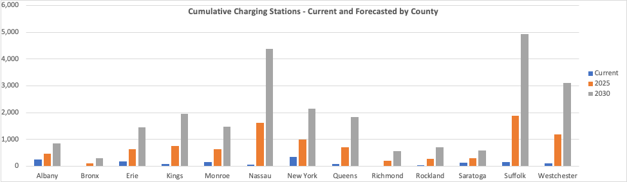
Projection
Forecast demand for charging stations
based on forecasted EV sales in Top counties

Slide 16
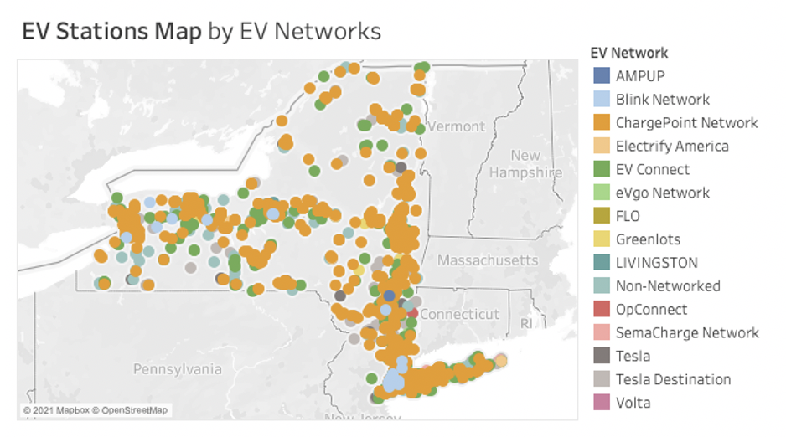
How good is the ranking system? Fact Check

Slide 17
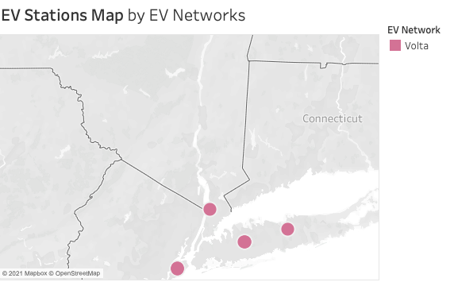
How good is the ranking system? Fact Check
Westchester
Suffolk
Richmond
Nassau

Slide 18
Key Takeaways
Volta already has 4 stations
Outside NYC
Best additional Site Selections
Suffolk Westchester
Nassau Richmond
Erie Orange
Monroe
Albany
Inside NYC
Best additional Site Selections
EV Trending
Queens Kings
Manhattan Bronx
Forecast shows EV sales increase, EV stations need is a trend

Slide 19
Future Work
01
Predictive Regression model
User/Revenue data
02
Unsupervised Learning
stations cluster
03
different advertising rate
Label stations for
Urban / Suburb / Rural
04
NLP Research
customer reviews

Slide 20
Thank you!
SYNYC
Don’t forget
Charging away from Climate Change
Notes:
Thank you so much. Bye : )

Slide 21
Appendix 1- 4

Slide 22
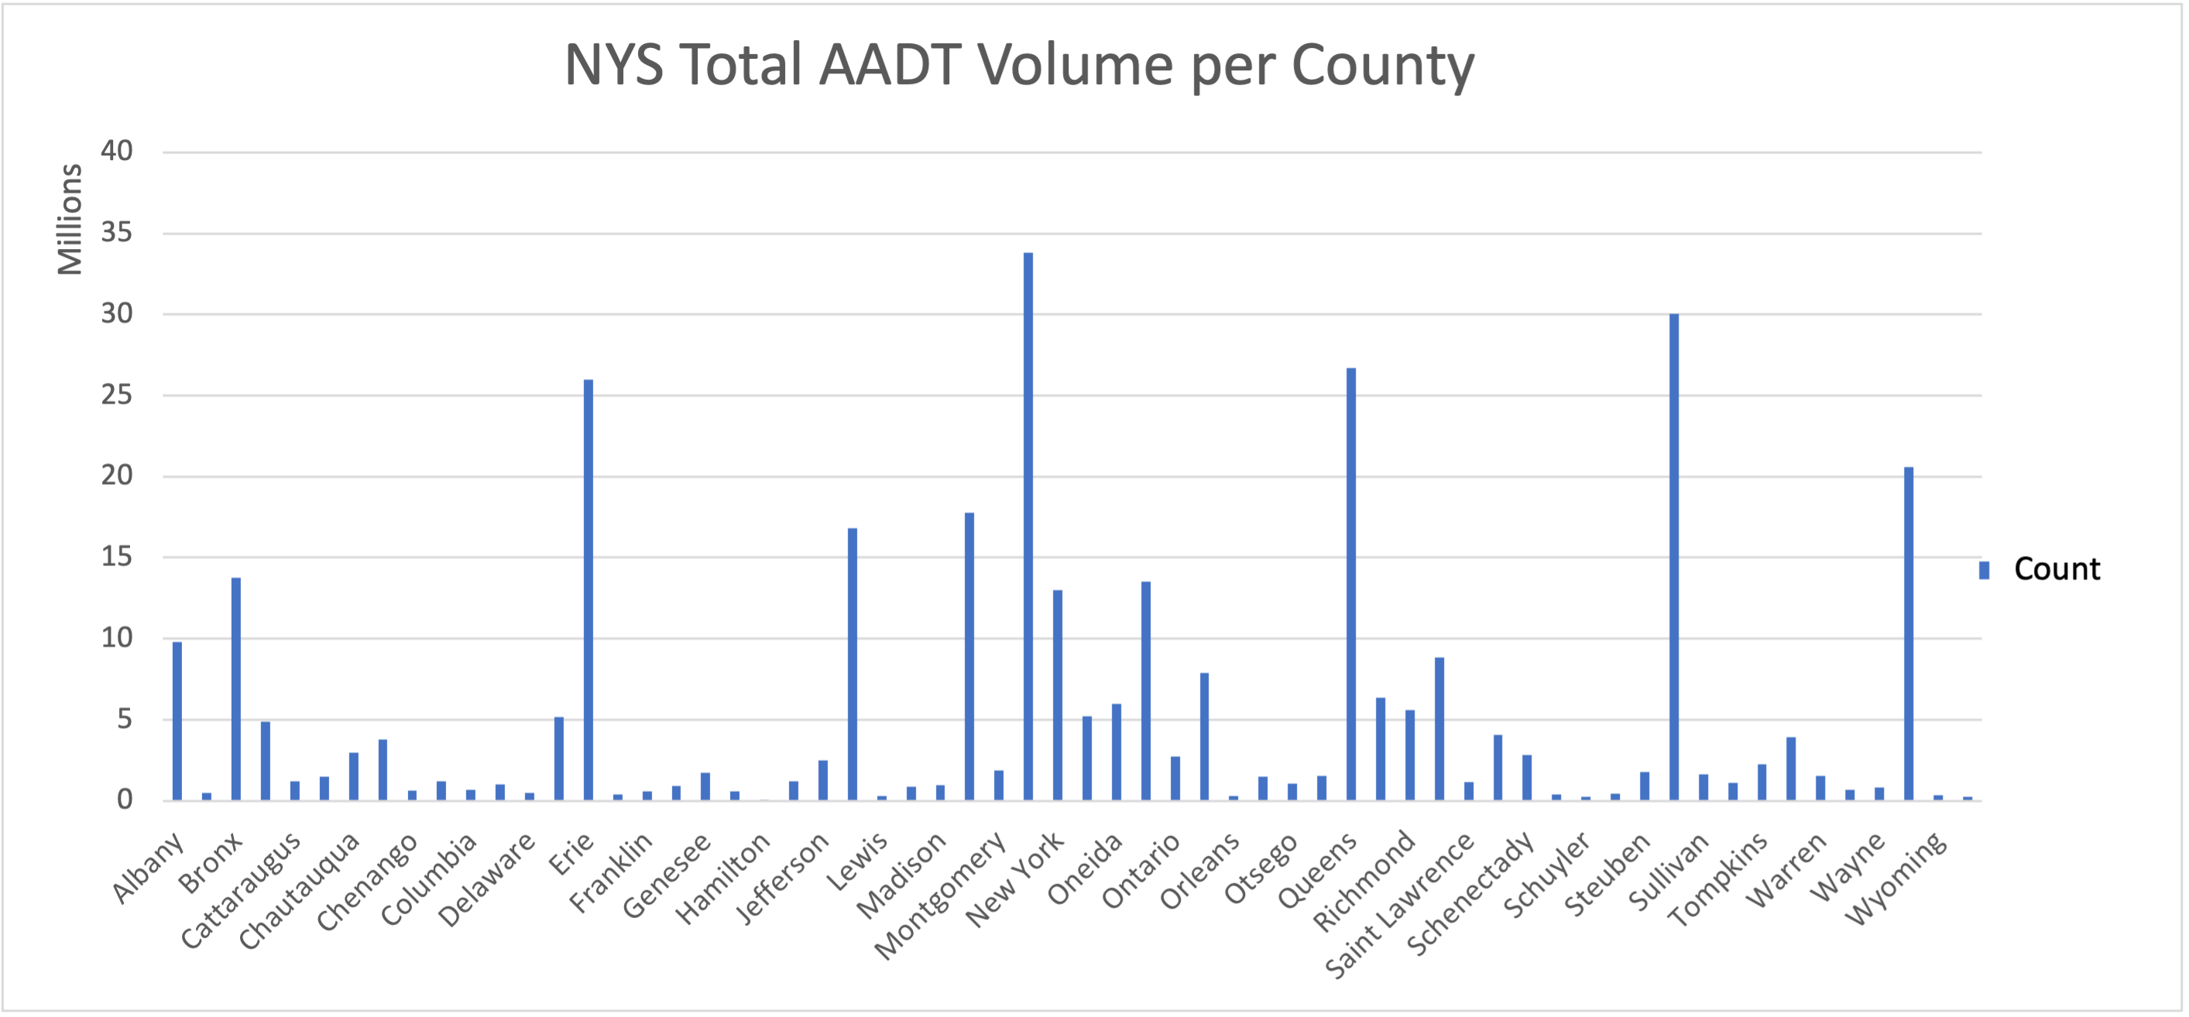
1

Slide 23
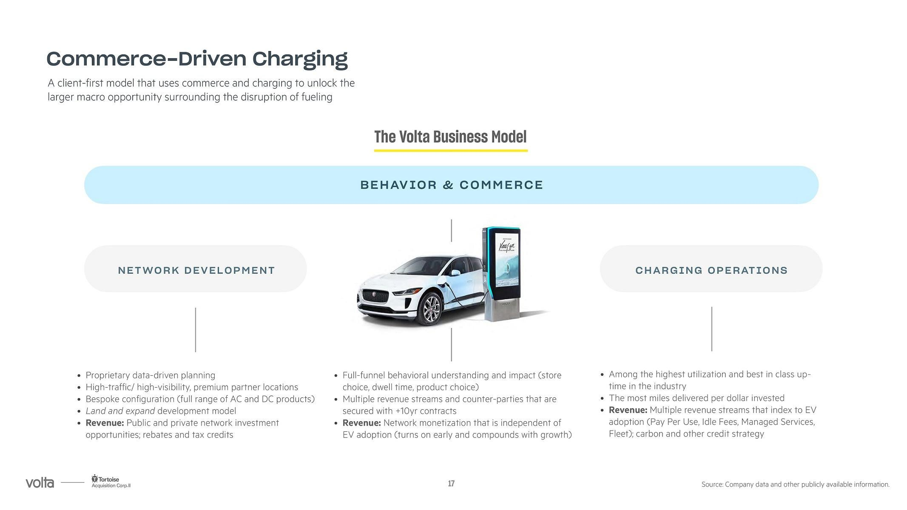
2
Location = Ad reach
EV needs
High Traffic Location
Economic

Slide 24
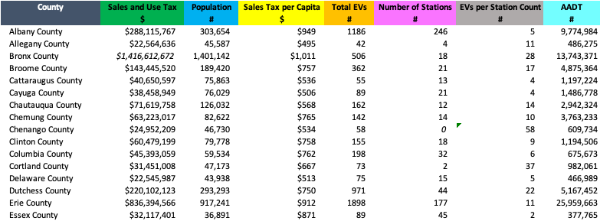
3
Ranking Excel Table

Slide 25
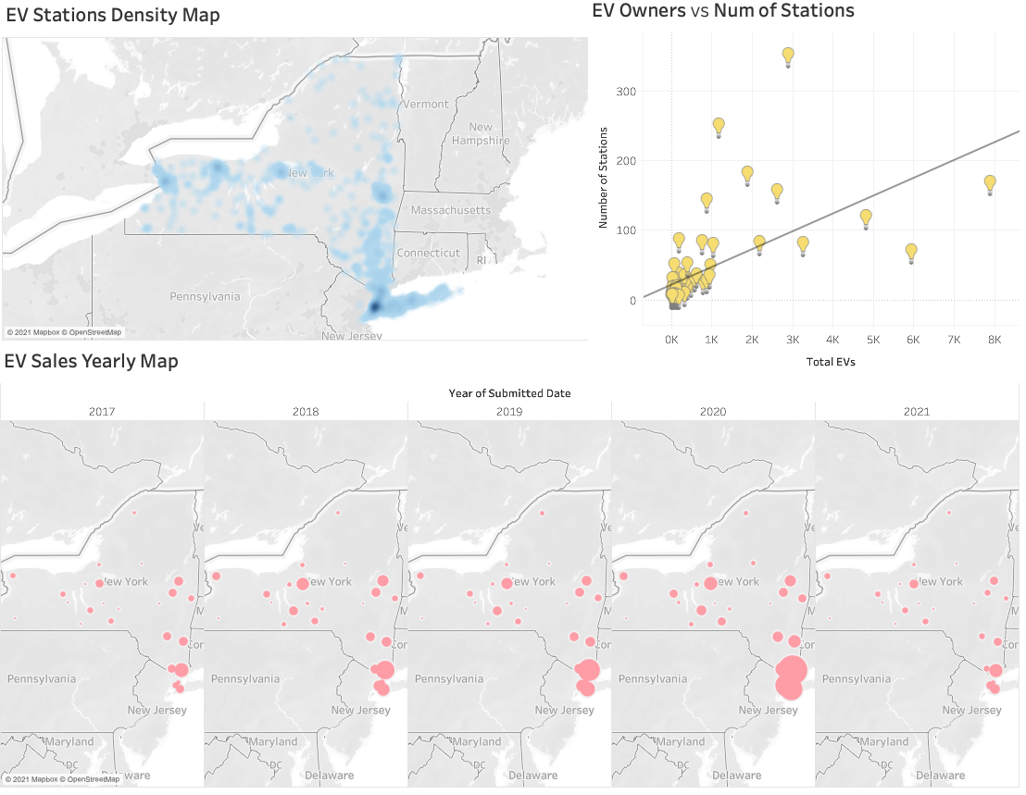
4
Tableau dashboard

